Slide 1
STORYTELLING
Designers use storytelling to get insight into users, build empathy and reach them emotionally.
Designers create personas to represent target users and add conflict to stories that reflect their user journeys and problems.
Crafting stories, designers can better understand what users want from a solution.

Slide 2
How Storytelling Works in Design
Good stories always captivate audiences. In user experience (UX) design, you use storytelling throughout the design process to ensure that all work focuses on the users’ needs and the value you want to give those users.
After completing design research to understand your users’ needs and desires, you use your insights to tell a story about who your users are, what they need and how you’ll provide that.
This story makes it easy for everyone involved in the project to empathize with the users and ensure that their work matches the story. Having a story throughout your project means marketing the design at the end of the design process is also straightforward, as you already know exactly which story to tell to show how your product provides value.
“People think that stories are shaped by people. In fact, it’s the other way around.” —Terry Pratchett, Famous fantasy author

Slide 3
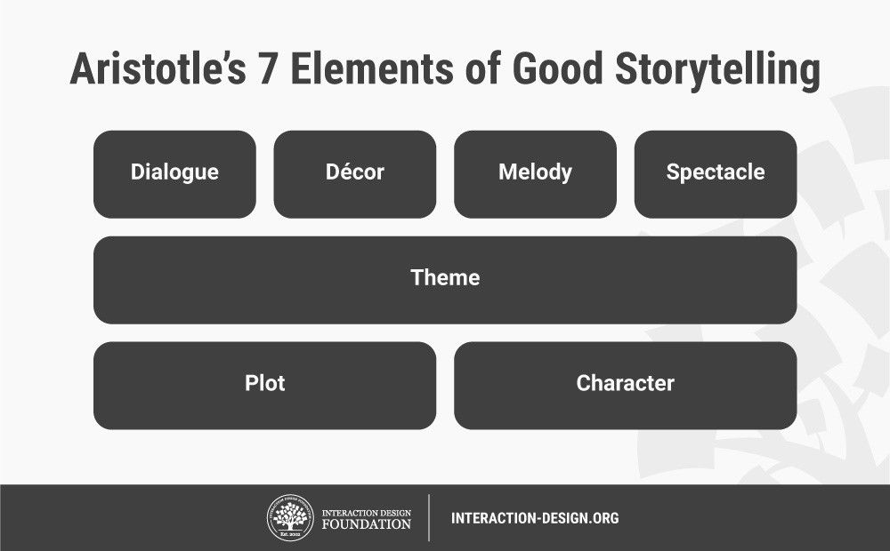
What Makes Good Stories?

Slide 4
Plot – What are users trying to achieve/overcome?
Character – Who are the users: not just demographically, but what insights do you need to understand what they (and their needs) are truly like?
Theme – How can you establish a trustworthy presence to them and still set yourself apart from competitors? How will you reflect the overall obstacles users must overcome?
Dialogue/Diction – What will your design say to users and how? Does a formal/informal tone match their expectations? How much text is appropriate?
Melody – How will the overall design pattern appear pleasant and predictable to users, moving them emotionally?
Décor – How will you present everything so the graphics match the setting the users can sense? Would a classic design or stylized, niche layout meet their expectations?
Spectacle – How can you make your design outstanding so users will remember it?

Slide 5
How to Reach Users through Stories
Define your target users with personas – to envision users’ likely experiences and gain empathic insights. Personas are based on user research but tell a story about your insights. An example persona might be “Rick”, a 47-year-old manager struggling with his work–family-life balance. He even works on his train commutes. Feeling drained, he wants better control of his life.

Slide 6
Create a plot, with conflict – to make the personas heroes and envision how they can overcome specific problems using your design. Make this a mapped-out journey or storyboard with each persona’s aim/s clearly defined. E.g.:
Rick discovers your (yet-to-be-designed) time-management app online. He downloads it and completes your questionnaire about work commitments, family, outgoings, etc.
He starts using your app, letting it collect data from his phone and fitness tracker about time on various tasks/activities, stress levels, alertness, etc.
After a week, your app charts his tasks and activities, including sleep, heart-rate data, etc.
Tapping a phone tab, Rick sees time-management suggestions on how to become more productive, well-rested, etc.
He has the option to continue or suspend monitoring (e.g., if on holiday/vacation).

Slide 7
Give your design the supporting role – show it improving your persona’s/user’s life and how easy it is to use. For example, consider how many steps Rick needs to use your app and if voice-controlled devices at home might influence its suggestions.
Work with the setting –When and where users use your design is vital for building empathy. For Rick, it’s the home, train and workplace. But what about (e.g.) busy professionals working from home?
Tailor the look/feel – Your design’s appearance is vital regardless of its functional benefits, so design the most appropriate (e.g.) layout, colors, typography. For example, Rick prioritizes an at-a-glance, easy-to-use design, but soothing colors would complement larger fonts, etc.

Slide 8
Always Consider
The What – The user problem/s you define: E.g., They work too much overtime because of…? Budgeting problems at home?
The Who – The users themselves, envisioned through personas. This includes people who play influential roles in the main user’s/persona’s story. You can identify them using customer journey maps.
The How – Your story arc, with a beginning, middle and end. From introducing the player/s at the beginning, you build towards their biggest problems (which many factors can affect) and finish with the happy ending your design delivers.
Your story narratives are “magic mirrors”—proving fine-tuned empathy and connection with users’ values—where users discover how to make their own happy endings.
Ultimately, your design should predict your target users’ actions at every level possible. Testing will help confirm how successful it is.

Slide 9
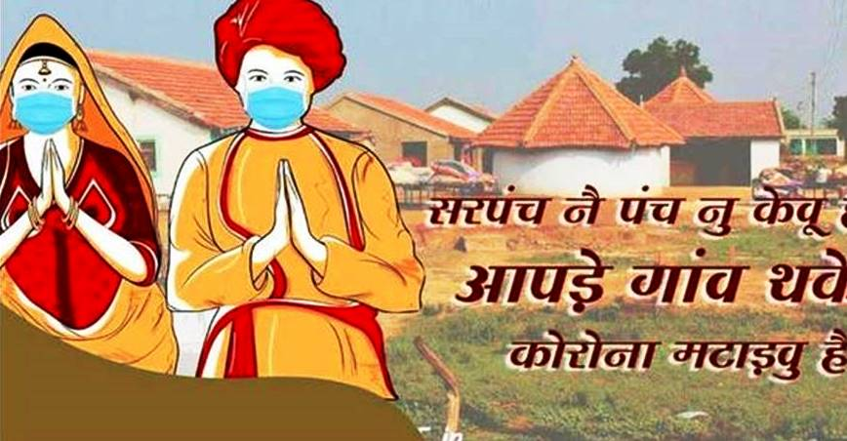
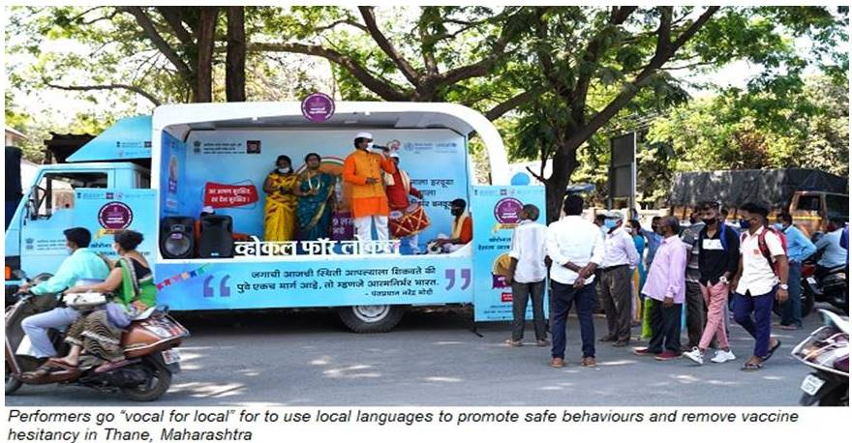
Vaccine Hesitancy & Storytelling in Different Parts of India:

